Slide 1
Lightning Talk
Matt “MP” Markezin-Press

Slide 2
Project ideas
Airport Delay Cascades
Road to WAR: Hockey Analysis
At the Speed of Bike

Slide 3
Cascade of Delays
PROBLEM: Can a set of delays at one airport in the US predict a cascade of delays at others?
The Data: FlightStats, OpenSkies and the FAA all have open datasets. Information available on length of delays, cause of delays and connection data.
Hypothesis: A delay at an east coast airport early in the morning can predict delays cascading across the United States.
Previous work: Department of Transportation, IATA and Travel Magazines have produced data analysis but without a geographic cause and effect angle

Slide 4
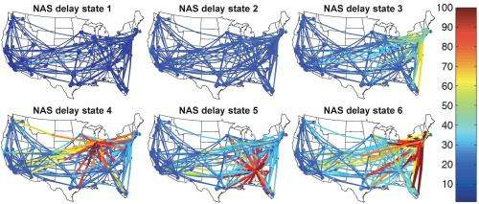
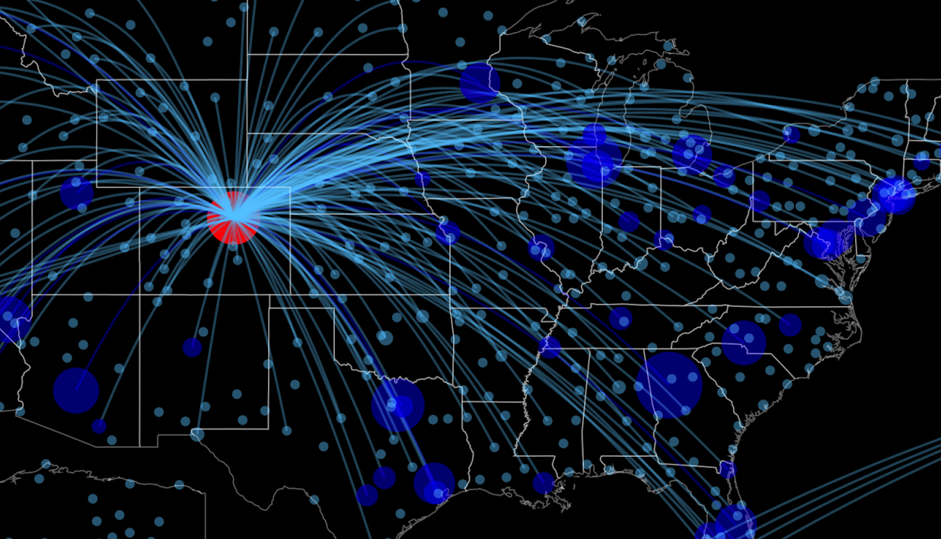
Cascade of Delays
MIT, NASA and IATA projects

Slide 5
Road to WAR
PROBLEM: Can a statistic that represents player quality in hockey help indicate better use of salary cap space.
The Data: The NHL in association with SAP has made all player performance statistics available. WAR On Ice (Blog) and General Fanager (Blog) have made their data available. Information includes player performance, salary information and advanced statistics.
Hypothesis: WAR as a statistic in undervalued in terms of salary cap space allocation.
Previous work: The hockey analytics community is very active and generally collaborative. WAR and Salary Information have been investigated before but only on a individual, not holistic basis

Slide 6
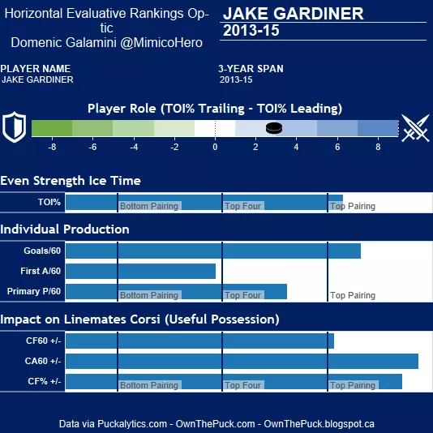
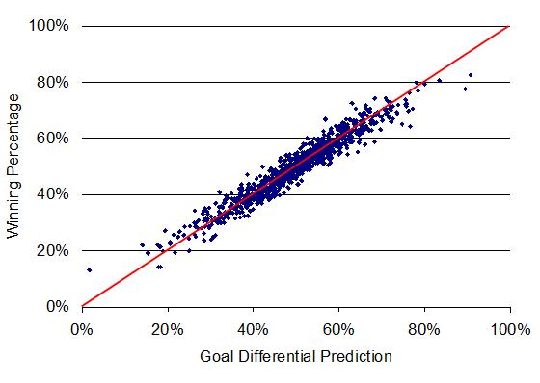
Road to WAR
Hero Chart and Goal Differential.
(HockeyAnalytics and OwnThePuck)

Slide 7
At the Speed of Bike
PROBLEM: Using most popular travel routes, is it faster to bike, use subway or take a cab?
The Data: CitiBike trip data, NYC Traffic Speed, and Subway station schedules are available for free access. In addition, API’s from WAZE and the MTA are available for further data interaction.
Hypothesis: Crosstown trips are faster for cars, short trips are best for bikes and longer trips are best for subways.
Previous work: There have been multiple isochronic projects and open sets for Google Maps. In addition FiveThirtyEight and others have investigated CitiBike travel times

Slide 8
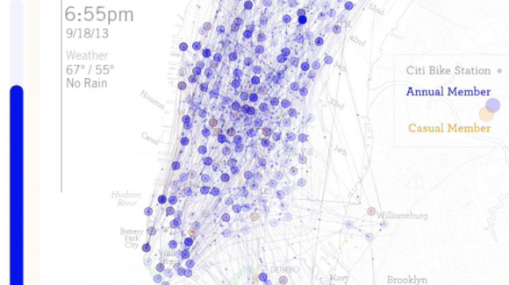
At the Speed of Bike
NYU Rudin/ linepointpath.com/Spatial Information Design Lab

